Slide 1
Implementation of Page Rank Algorithm using PySpark
Group - 6
Aditya Tripathi (202318046)
Anurag Choudhury (202318059)
Karan Sharma (202318018)

Slide 2
Purpose
The purpose of the project is to implement page rank using PySpark
We have imported Datasets from the library scikit-network and applied page rank on it

Slide 3
Tools used
PySpark
Networkx
Numpy
Matplotlib
Scikit-Network

Slide 4
Page Rank
A page Rank is a function that assigns a real number to each page in the web. Higher the page rank of a page, the more important it is

Slide 5
Avoiding Dead end
Dead end, a page that has no links out. Surfers reaching such a page
disappear, and the result is that in the limit no page that can reach a dead end can have any PageRank at all.
The second problem is groups of pages that all have outlinks but they never link to any other pages. These structures are called spider traps.

Slide 6
Two approaches to dealing with dead ends
Drop the dead ends from the graph, and also drop their incoming arcs. Doing so may create more dead ends, which also have to be dropped, recursively. However, eventually we wind up with a strongly-connected component, none of whose nodes are dead ends.
We can modify the process by which random surfers are assumed to move about the Web. This method, which we refer to as “taxation,” we have solved the problem of spider traps using this method

Slide 7
Spider Trap
To avoid the problem illustrated by the previous example, we modify the calculation of PageRank by allowing each random surfer a small probability of teleporting to a random page, rather than following an out-link from their current page.

Slide 8
Damping Factor
Here β is a chosen constant, usually in the range 0.8 to 0.9, e is a vector of all1’s with the appropriate number of components, and n is the number of nodes in the Web graph. The term βMv represents the case where, with probability β, the random surfer decides to follow an out-link from their present page. The term (1 −β)e/n is a vector each of whose components has value (1 − β)/n and represents the introduction, with probability 1 − β, of a new random surfer at a random page.

Slide 9
Steps
Spark Initialization
Removing dead ends
Calculating Page Rank with Damping Factor
Outputting of Results and graph analysis
Importing Datasets and libraries
Page Rank Initialization

Slide 10
Ranks of Dummy dataset using Damping Factor
Results
0 has rank: 0.071335.
1 has rank: 0.139924.
2 has rank: 0.073457.
4 has rank: 0.040489.
6 has rank: 0.073457.
7 has rank: 0.102454.
9 has rank: 0.104478.
10 has rank: 0.071335.
11 has rank: 0.125184.

Slide 11
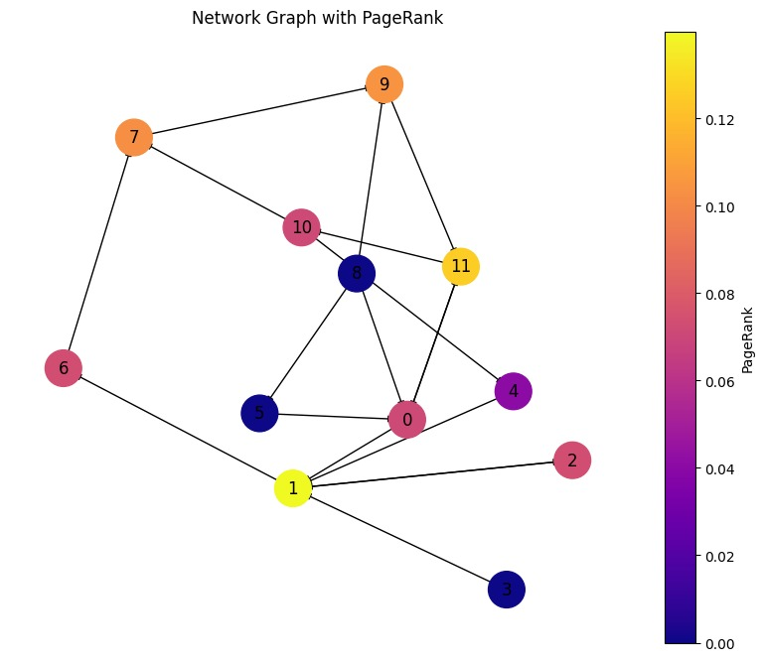
High PageRank Nodes: Node 1 has the highest PageRank of approximately 0.140. This suggests that it is a highly influential node within the network, likely because it has multiple incoming links from other important nodes. Node 11 also shows significant importance with a PageRank of approximately 0.125, suggesting it too is central or influential, probably serving as a major connector within the network.
Intermediate Influence: Nodes 9 and 7 have the next highest ranks, around 0.104 and 0.102 respectively. These nodes are likely to be important connectors or bridge points between different parts of the network, helping to facilitate the flow of information.
Lower PageRank Nodes: Node 4 has the lowest PageRank at approximately 0.040, indicating it is relatively less central or influential. It might be more peripheral within the network's structure or has fewer connections.
Connectivity and Structure: The graph layout shows that some nodes like Node 0, although not having the highest PageRank, are still quite central in terms of their positioning and connectivity to other nodes. This indicates a role in connecting various subparts of the network but not necessarily being the endpoint of many paths. Nodes like 2, 6, and 10 have similar PageRanks around 0.071 to 0.073, indicating a moderate level of influence and connectivity.
Learnings from the Graph: Centrality vs. PageRank: The nodes with the highest centrality (such as Nodes 1 and 11) receive more links from other nodes, which boosts their PageRank. This underlines the PageRank algorithm's reliance on not just the quantity but also the quality of incoming links—links from other important nodes contribute more to a node's score.

Slide 12
Rank of Karate club Datasets
11 has rank: 0.009591392453836521 0 has rank: 0.09683432408125801
33 has rank: 0.10032824022909359 22 has rank: 0.014609108561666393
1 has rank: 0.05270896442056386 12 has rank: 0.014671383716681103
23 has rank: 0.03156737208822522 2 has rank: 0.05700984924152858
13 has rank: 0.02962050159810053 24 has rank: 0.021037773261271597
3 has rank: 0.03583685480385702 14 has rank: 0.014609108561666393
25 has rank: 0.020962943783278818 4 has rank: 0.02204313601476537
15 has rank: 0.014609108561666393 26 has rank: 0.01505913384682437
5 has rank: 0.029220283927115134 27 has rank: 0.025665546554312527
16 has rank: 0.016825479420855997 6 has rank: 0.029220283927115134
17 has rank: 0.01460543836293604 28 has rank: 0.019579305879488463
7 has rank: 0.02453785662961431 18 has rank: 0.014609108561666393
29 has rank: 0.026315470010195345 8 has rank: 0.02983146692371576
19 has rank: 0.019688083331422267 30 has rank: 0.024656816968365372
31 has rank: 0.037268795878143954 9 has rank: 0.014346836678202263
20 has rank: 0.014609108561666393 10 has rank: 0.02204313601476537
21 has rank: 0.01460543836293604 32 has rank: 0.07127234878319948

Slide 13

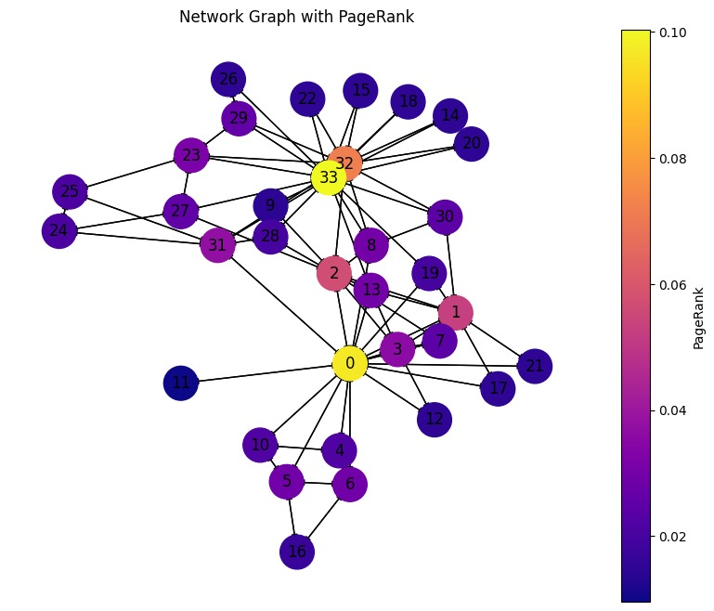
Central Nodes: Node 33 has the highest PageRank of approximately 0.100, highlighting its central role in the network. Its position in the graph, connected to many other nodes, suggests it acts as a major hub or connector within the club, likely interacting with most members. Node 0 follows closely with a PageRank of about 0.097, also indicating a significant centrality and influence within the club. This node, like Node 33, serves as a key player in the network.
Influential Nodes: Node 2 and Node 1, with PageRanks of 0.057 and 0.053 respectively, are also quite central but less so than Nodes 33 and 0. These nodes might represent individuals who are influential within certain subgroups but less so across the entire network.
Connector Nodes: Nodes like 31 and 32, with PageRanks of 0.037 and 0.071 respectively, are interesting because they connect different clusters or subgroups within the network. Their strategic positions allow them to bridge communications or interactions between different groups of members.
Peripheral Nodes: Nodes such as 11, 14, 18, and 20 have relatively low PageRank values (around 0.01), indicating they are more peripheral within the social structure of the karate club. They might be newer members or less active ones within the group dynamics. Interpretation of PageRank Results High
PageRank Nodes: These nodes, especially Nodes 33 and 0, likely represent the instructors or the most charismatic members of the club, who interact with most of the other members and thus hold significant sway or influence. Intermediate PageRank Nodes: Nodes with medium PageRank values are likely important but not pivotal members. They have their own circles or subgroups where they are influential, which contributes to the overall connectivity of the network.
Low PageRank Nodes: These nodes are on the periphery of the network's social structure. They might interact less frequently with other members or be less central to the club's activities.

Slide 14
Rank of Painters Datasets
0 has rank: 0.06039416801563977
11 has rank: 0.0512668138929923
1 has rank: 0.06946039445281695
12 has rank: 0.08438379958754563
2 has rank: 0.12498876778993409
13 has rank: 0.01864369075381464
3 has rank: 0.10953832377376878
4 has rank: 0.11001955290952314
5 has rank: 0.04712884888989093
6 has rank: 0.01864369075381464
7 has rank: 0.053088437933864197
8 has rank: 0.044872833039942134
9 has rank: 0.15675843640257367
10 has rank: 0.050812241803879166

Slide 15
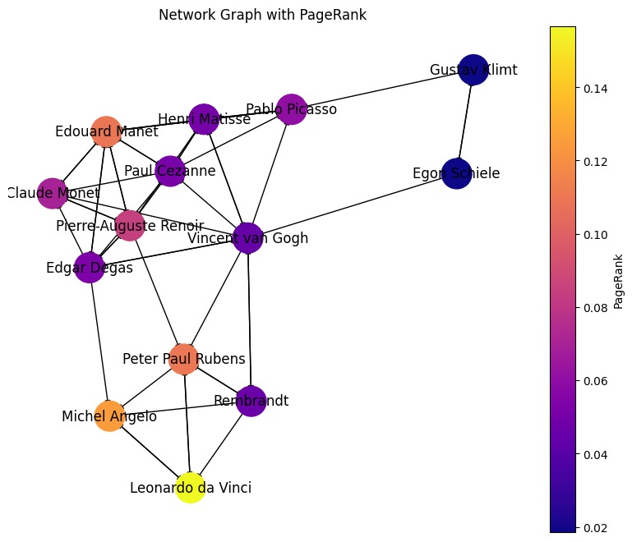
Central Figures: Leonardo da Vinci seems to have a prominent color which usually indicates a higher PageRank. His central position and vivid coloration suggest he is highly influential within this network, possibly representing a foundational influence over other painters.
Influential Figures : Vincent van Gogh and Paul Cezanne also show strong colors, suggesting they are key nodes within the network. This aligns with their historical impact on art, particularly post-impressionism, and their influence on later artists. Gustav Klimt and Egon Schiele, closely positioned, highlight a particular artistic connection, possibly indicating a shared stylistic or cultural influence, aligning with their roles in modern art movements.
Connections and Influence: The graph shows dense connections around central figures like Paul Cezanne, Vincent van Gogh, and Claude Monet, suggesting these individuals not only contributed significantly to art but also influenced numerous other artists within the network. Lesser colored nodes like Michelangelo and Peter Paul Rubens might indicate less direct influence or fewer connections within this specific network of painters.

Slide 16
Conclusion
From the project we have calculated the page rank of two datasets.
We have analysed it through network graphs
We have also dealt with dead end nodes by dropping and spider trap nodes by taxation

Slide 17
References
https://scikit-network.readthedocs.io/en/latest/reference/data.html

